Slide 1

What is MvvmCross?
13th December 2012
@slodge

Slide 2
In 2005…
10 years of dev – C++, VB, Java, Javascript, …
A year off travelling
from Argentina to Zambia
DeveloperDeveloperDeveloper
1 conclusion
I am a dinosaur

Slide 3
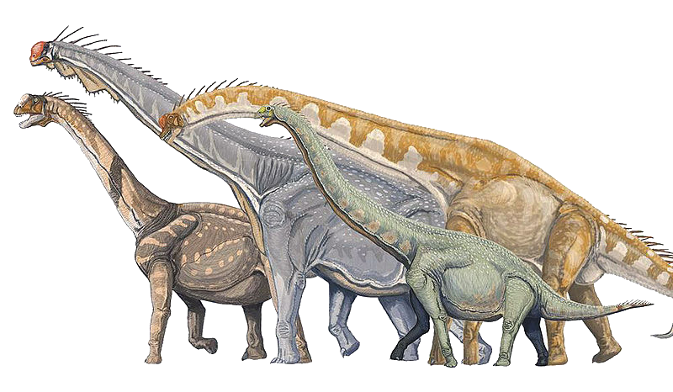
What is MvvmCross?
What killed the dinosaurs?
13th December 2012
@slodge

Slide 4
What killed the dinosaurs?
What is MvvmCross?

Slide 5
What killed the dinosaurs?
Let’s take a look at their code!
TwitterSearch

Slide 6
What killed the dinosaurs?
Separation of concerns
Use of tools
Tight coupling
Design to test
Design to share
Design to reuse
Cut and Paste – and File Linking
#if
Unit tests
Learn to adapt
Being cold blooded
Learn Interface Driven Development
Reusing code
They uploaded binaries instead of source to GitHub
They didn’t die!

Slide 7
Save The Dinosaur
Here’s what some others are doing…
What you do… is up to YOU

Slide 8
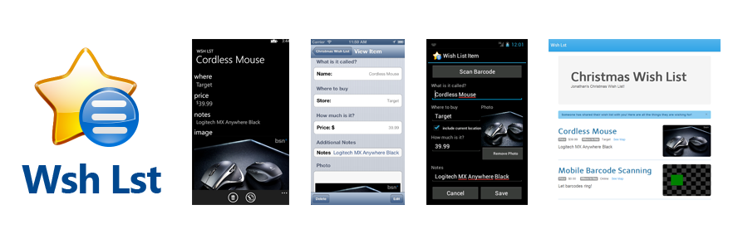

WshLst
https://github.com/Redth/WshLst/

Slide 9
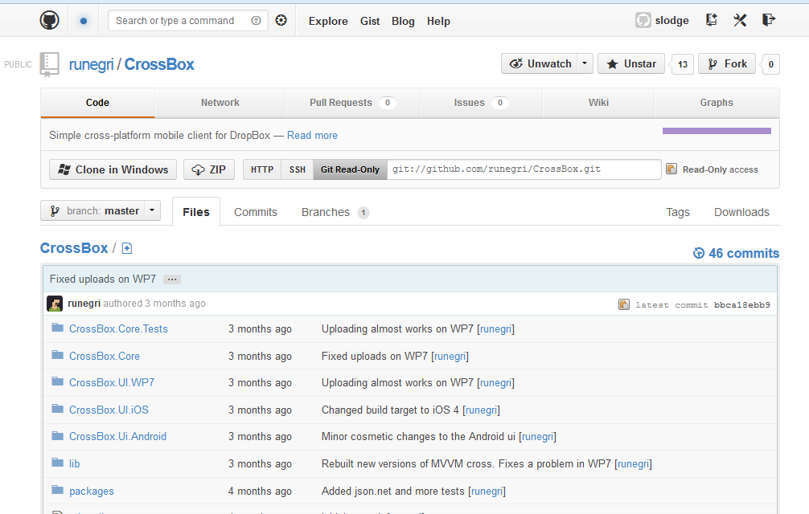
CrossBox
https://github.com/runegri/CrossBox

Slide 10
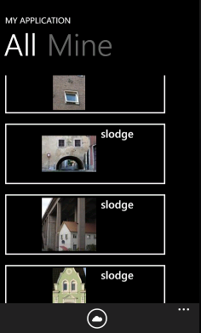
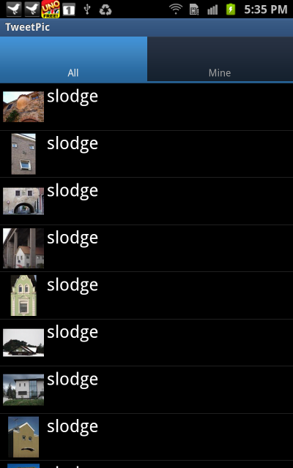
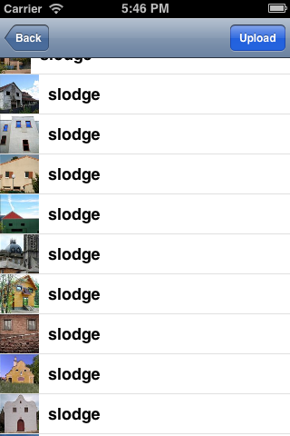
TweetPic
http://bit.ly/mvxTweetPic

Slide 11
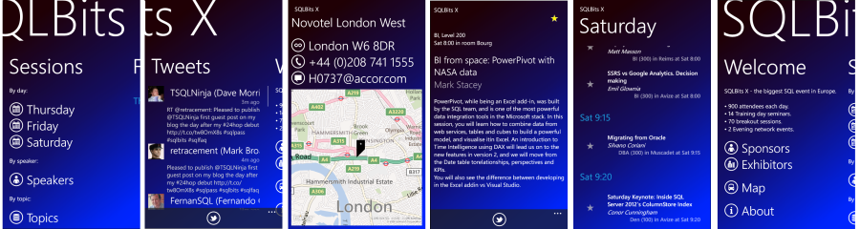
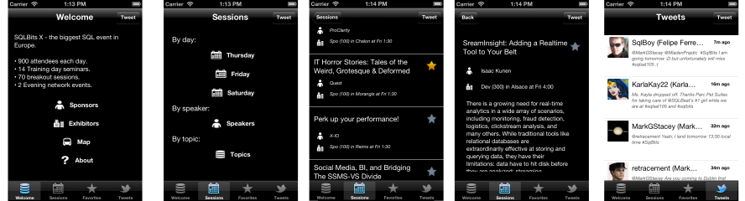
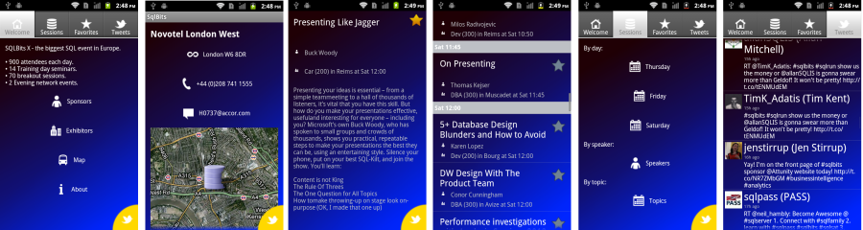
SQL Bits X
http://github.com/slodge/MvvmCross

Slide 12
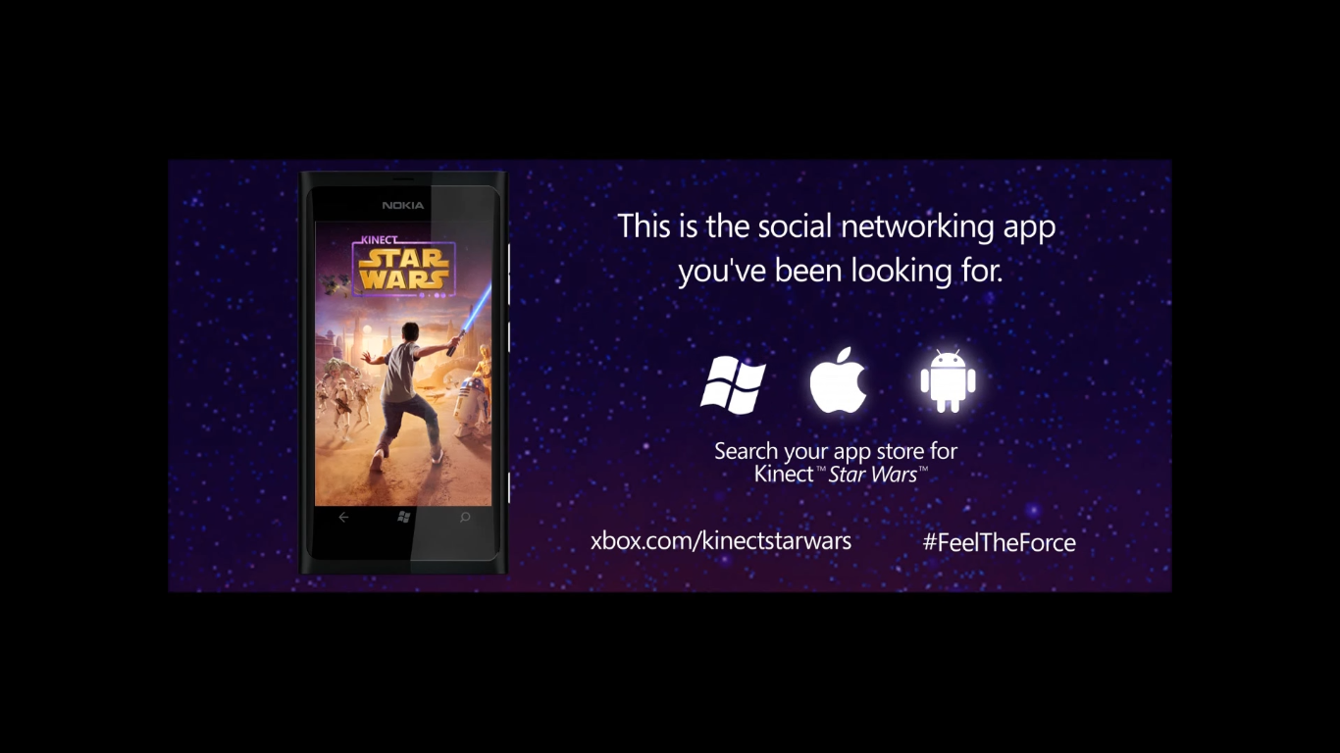
Star Wars Kinect
@slodge @imaji @mrlacey @sichy @touch4apps …

Slide 13

Aviva Drive
http://www.aviva.co.uk/drive/

Slide 14
CheeseBaron

Slide 15
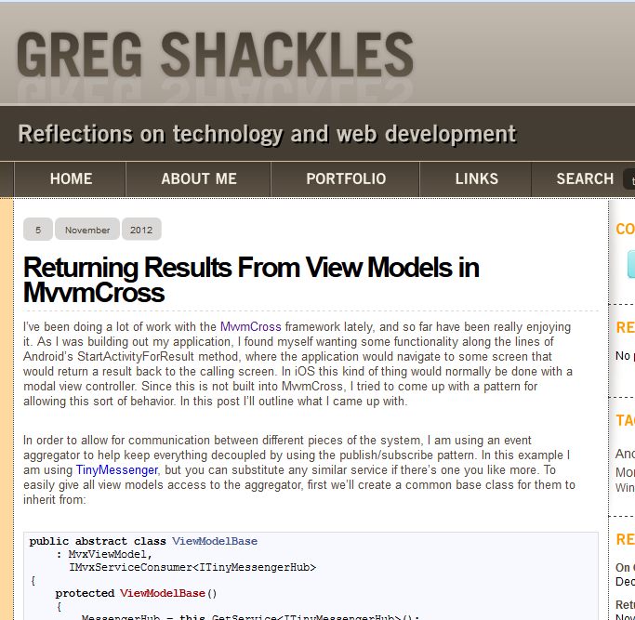
GShackles
http://bit.ly/mvxgshac

Slide 16
E-Naxos

Slide 17
Dan in Italy

Slide 18
Zoldeper Blooor

Slide 19
BUILD - Daniel Plaisted

Slide 20
Sphero - Ball Control

Slide 21
Sorry
So busy talking about the dinosaurs…
I forgot to talk about MvvmCross
Mvx is a library I started a year ago. I use it in my work for:
Sharing code
Reusing code
Testing code
Giving large projects a backbone
It is evolving.
It is awesome.

Slide 22
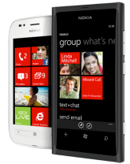
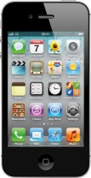
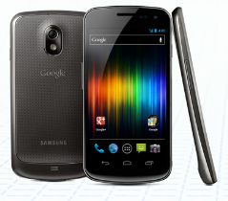
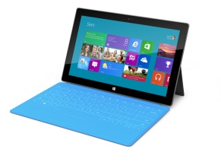
C# from Server to Client
Data Access
Business Logic
Presentation
Service Consumption
Local Data/Services
Business Logic
UI Logic
WP7
iOS
Droid
Win8

Slide 23
Not as cool as dinosaurs
Data Access
Business Logic
Presentation
Service Consumption
Local Data/Services
Business Logic
UI Logic
WP7
iOS
Droid
Win8

Slide 24
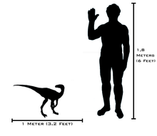
Images from Wikipedia Commons:
http://en.wikipedia.org/wiki/File:Macronaria_scrubbed_enh.jpg

Slide 25

Thanks
http://cirrious.com
http://slodge.blogspot.com
http://github.com/slodge/mvvmcross
me@slodge.com
@slodge
Stuart Lodge

Slide 26
Xamarin
Seminar
Please give us your feedback
http://bit.ly/xamfeedback
Follow us on Twitter
@XamarinHQ
13th December 2012
Notes:
Book promo code

